Slide 1

MACHINE LEARNING AND CONTENT ANALYTICS
FAKE NEWS DETECTION​
Py-truth
Konstantina Georgiopoulou (p2822004)
Anastasios Theodorou (p2822007)
Christos Kallaras (p2822009) ​
Stavros Kasiaris (p2822022)

Slide 2
Introduction
Business Question 1
Business Question 2
Business Question 3
Which machine learning algorithms can perform well in detecting fake news?
How well these algorithms can perform in classify news in a test set?
Which algorithm performs better for fake news detection?
The project: Based on a dataset of fake and true news and with the help of neural network algorithms we aim to find a way of distinguish fake from real news.
Visions/goals: To help people to be properly informed and have better sense of justment.

Slide 3


Time for Fun!
https://kahoot.it/challenge/02914025?challenge-id=a9396d8e-19dd-493e-acb7-5da3113023ed_1631814219021
Game PIN: 02914025

Slide 4
Step 1
Finding Dataset
Step 2
ETL (Extract – Transform – Load) Process
Methodology
Step 3
Apply Neural Network (NN) Algorithms (Feed Forward NN, Embedding, Doc2vec, Recurrent NN,Bert) and Logistic Regression
Step 4
Evaluate the Models
Step 5
Results and Conclusions

Slide 5
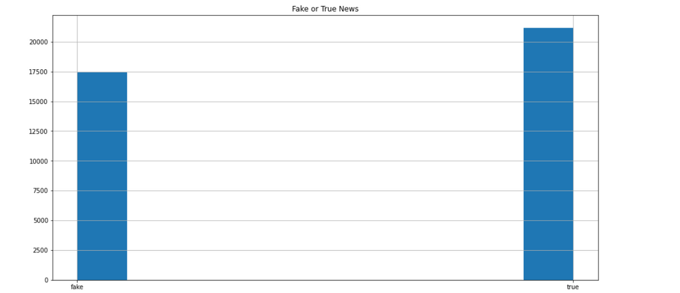
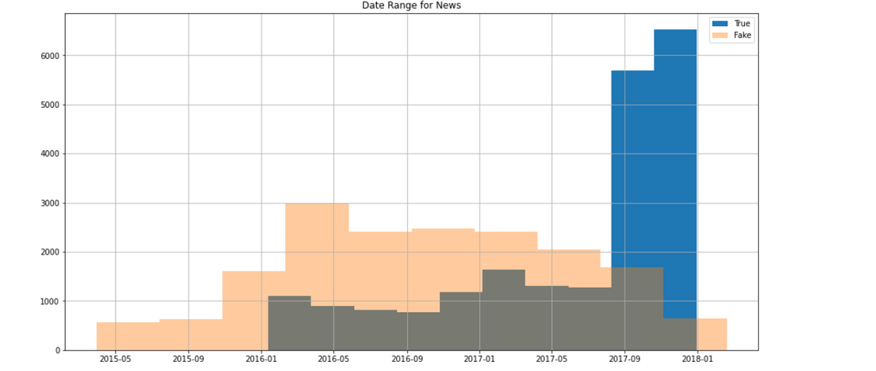

Dataset Overview(1)
The dataset was found in Kaggle and consisted of nearly 37k news. 20k of them was ''True'' and the rest 17k were ''Fake''.
Check for missing values
Check for dublicates
Balanced Data
Date Range from 2015-2018

Slide 6
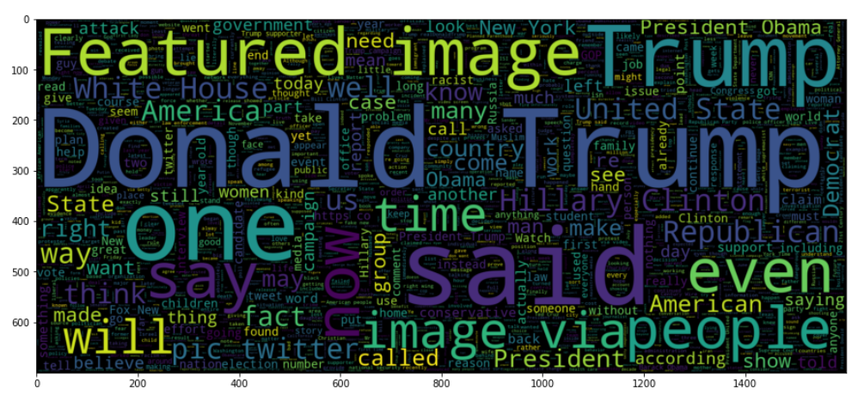
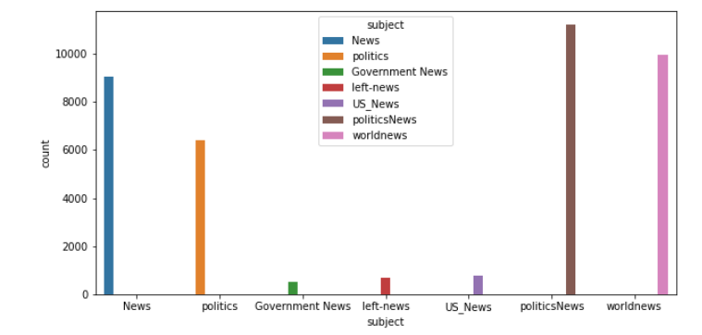
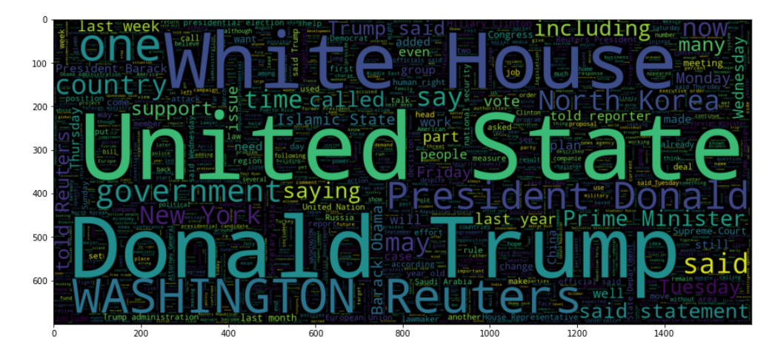
Dataset Overview(2)
Fake News
True News
Mainly Political Subjects

Slide 7
Data Cleaning​
Links
Twitter Users
Capitalization
We remove URLs from URLs text column.
We remove Twitter users and replace them with: @twitter-handle.
We make words in lowercase.
Numbers
(Reuters)
Punctuation
We remove numbers except from 9/11.
We remove “(reuters)” from the news.
We remove all of the punctuations except for the exclamation point.
Remove “'s”
Date Words
“'s” need to be removed so that it doesn't become a false indicator of true news.
We remove all date words.

Slide 8

Algorithms
Logistic Regression, Feed Forward Neural Network with Label Encoding, Feed Forward Neural Network with Embeddings, Recurrent Neural Network,Pre-Trained BERT Model

Slide 9
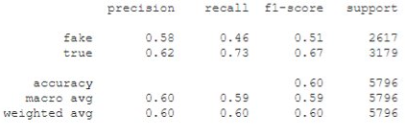
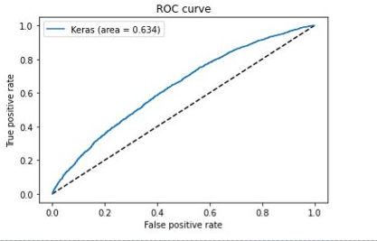
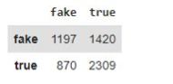
Logistic Regression with Doc2Vec-DBOW
CLASSIFICATION REPORT
ROC CURVE​
CONFUSION MATRIX

Slide 10
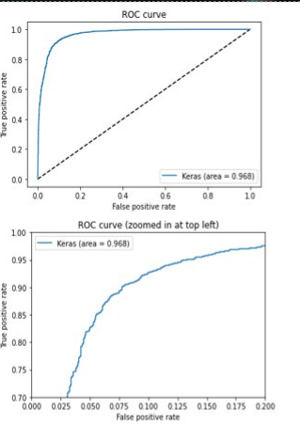
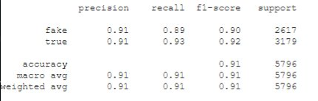
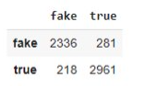
Logistic Regression with Doc2Vec-DM
CLASSIFICATION REPORT
ROC CURVE​
CONFUSION MATRIX

Slide 11
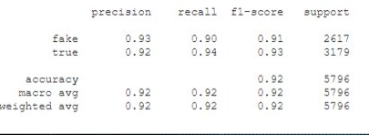
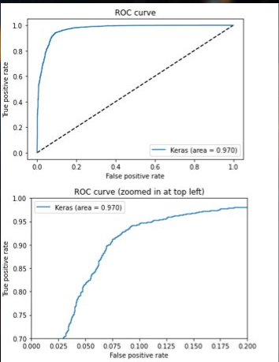
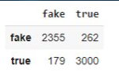
Logistic Regression with Doc2Vec-DBWO & DM
CLASSIFICATION REPORT
ROC CURVE​
CONFUSION MATRIX

Slide 12
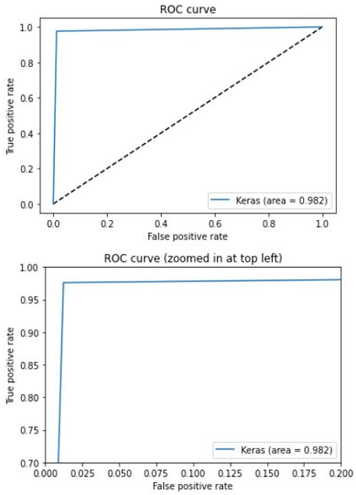
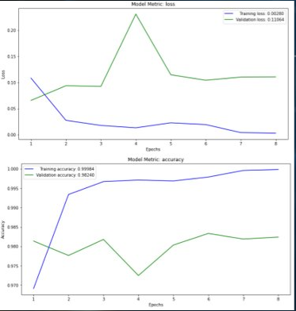
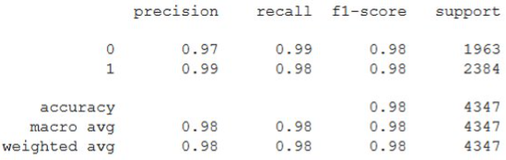
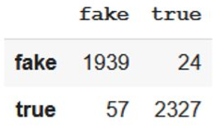
Feed Forward Neural Network with Label Encoding
BINARY CROSS ENTROPY LOSS
AND ACCURACY
CLASSIFICATION REPORT
ROC Curve
CONFUSION MATRIX
TARGET AUDIENCE
Presentations are communication tools that can be demonstrations.

Slide 13
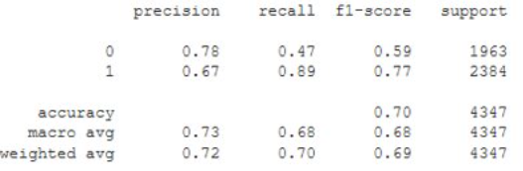
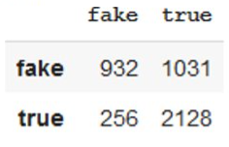
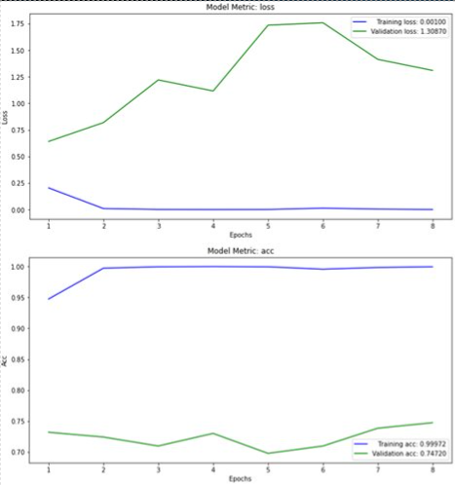
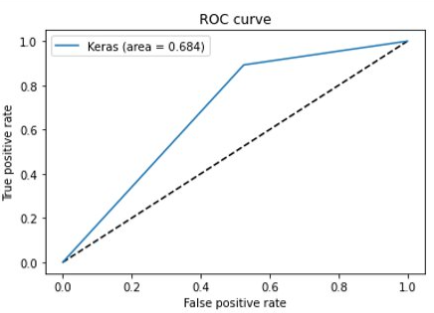
Feed Forward Neural Network with Embeddings
BINARY CROSS ENTROPY LOSS AND ACCURACY
CLASSIFICATION REPORT
CONFUSION MATRIX
ROC Curve

Slide 14
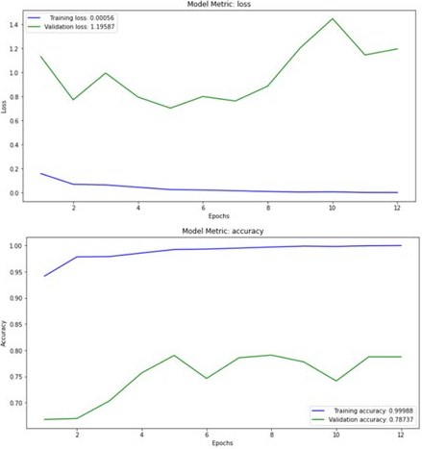
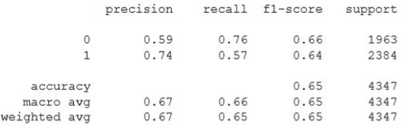
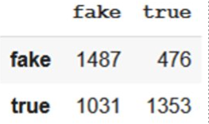
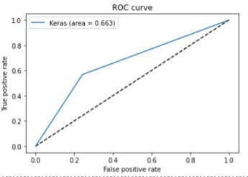
Recurrent Neural Network
BINARY CROSS ENTROPY LOSS
AND ACCURACY
CLASSIFICATION REPORT
CONFUSION MATRIX
ROC Curve

Slide 15
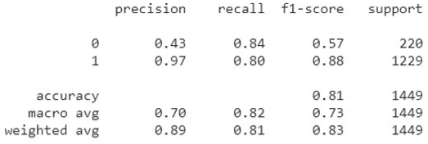
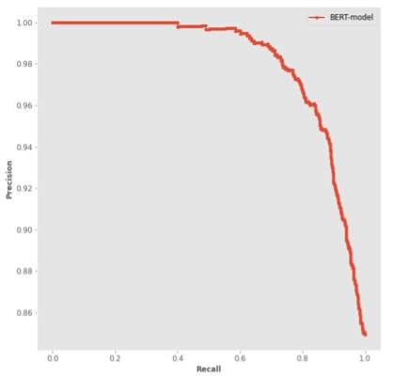
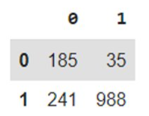
Pretrained BERT model – based on "Title"
CLASSIFICATION REPORT
PRECISION RECALL CURVE
CONFUSION MATRIX

Slide 16

Best model
Feed forward with label encoding – accuracy 98%​
Conclusion
Comments
Effective models – also confirmed through dummy classifier (accuracy 51%)
Νature of the data also helped in order to have a good training
Future work
Additional sources for better training​
Greek data for multi-language​
Use 'text' instead of 'title' in BERT model

Slide 17


Time Plan
Phase A
22/06
25/06
01/07
11/07
12/07
21/07
25/07
Introduction (Pre-Analysis)
Our project & Vision/Goals
Methodology
Members/Roles & Time plan
Data Collection and Analysis
Data
Processing
Algorithms and NLP architectures/systems
Phase B
01/08
09/08
17/08
24/08
25/08
29/08
Experiments – Setup, Configuration ​
Results & Quantitative Analysis
(incl.
visualizations)
Qualitative & Error Analysis
Discussion, Comments/
Notes and Future Work
Bibliography & Appendices
Complete the assignment and the presentation.

Slide 18




We are a super team!
Konstantina Georgiopoulou
Christos Kallaras
Anastasios Theodorou​
Stavros Kasiaris
Data Processing, Validation & Design
Application Design and Development
Project Management and Designing
Modeling and Testing

Slide 19
Thank You!

Slide 20


